Slide 1

Studio: Unintentional Good
A5:
SKETCHING, LOW-FI PROTOTYPING & PILOT USABILITY TESTING

Slide 2
What's Inside
01 | Intro
02 | Sketching Explorations
03 | Selected Interface
04 | Low-Fi Prototype
05 | Testing Methodology
06 | Testing Results
07 | Observations & Implications
08 | Appendix

Slide 3
01
Intro

Slide 4
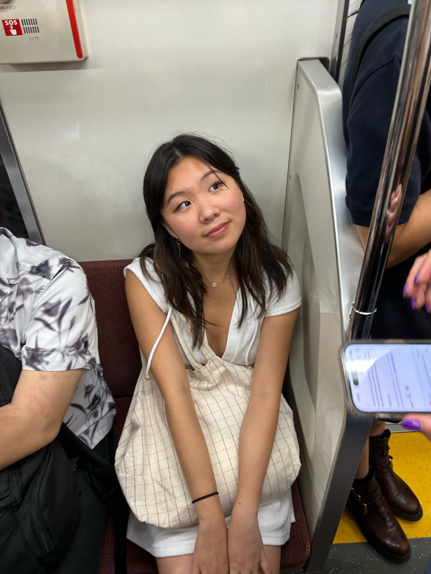


The Team
Emily Deng
Jenna Kim
Ariane Lee
Ariane Lee
Computer Science ‘25
Computer Science ‘25
Symbolic Systems ‘25
Computer Science ‘25

Slide 5
Problem
Solution
People find it difficult to find services that suit their personal needs, and online reviews from strangers are often unhelpful with the search.
A service recommendation app where you can see and request recommendations from friends & friends of friends for things like plumbers, mechanics, nannies, etc.

Slide 6
Removes clutter of other categories and focuses on addressing needs
Solution
Can explicitly solicit recommendations instead of just relying on existing content
A service recommendation app where you can see and request recommendations from friends & friends of friends for things like plumbers, mechanics, nannies, etc.
Can get trusted recommendations from a network that extends beyond just direct connections

Slide 7
02
Sketching Explorations

Slide 8
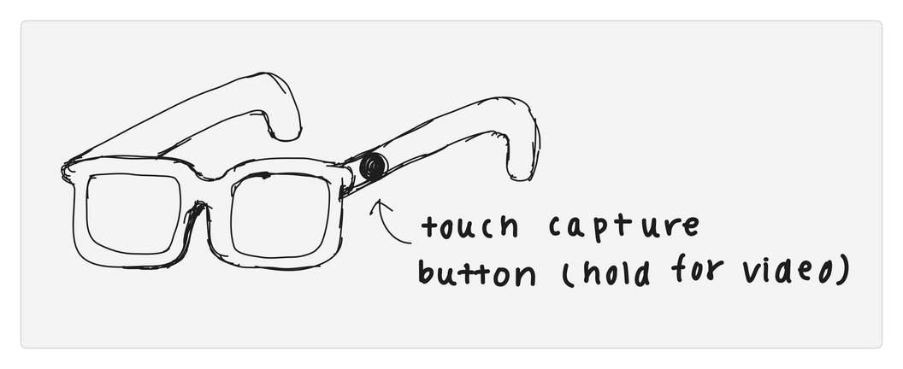
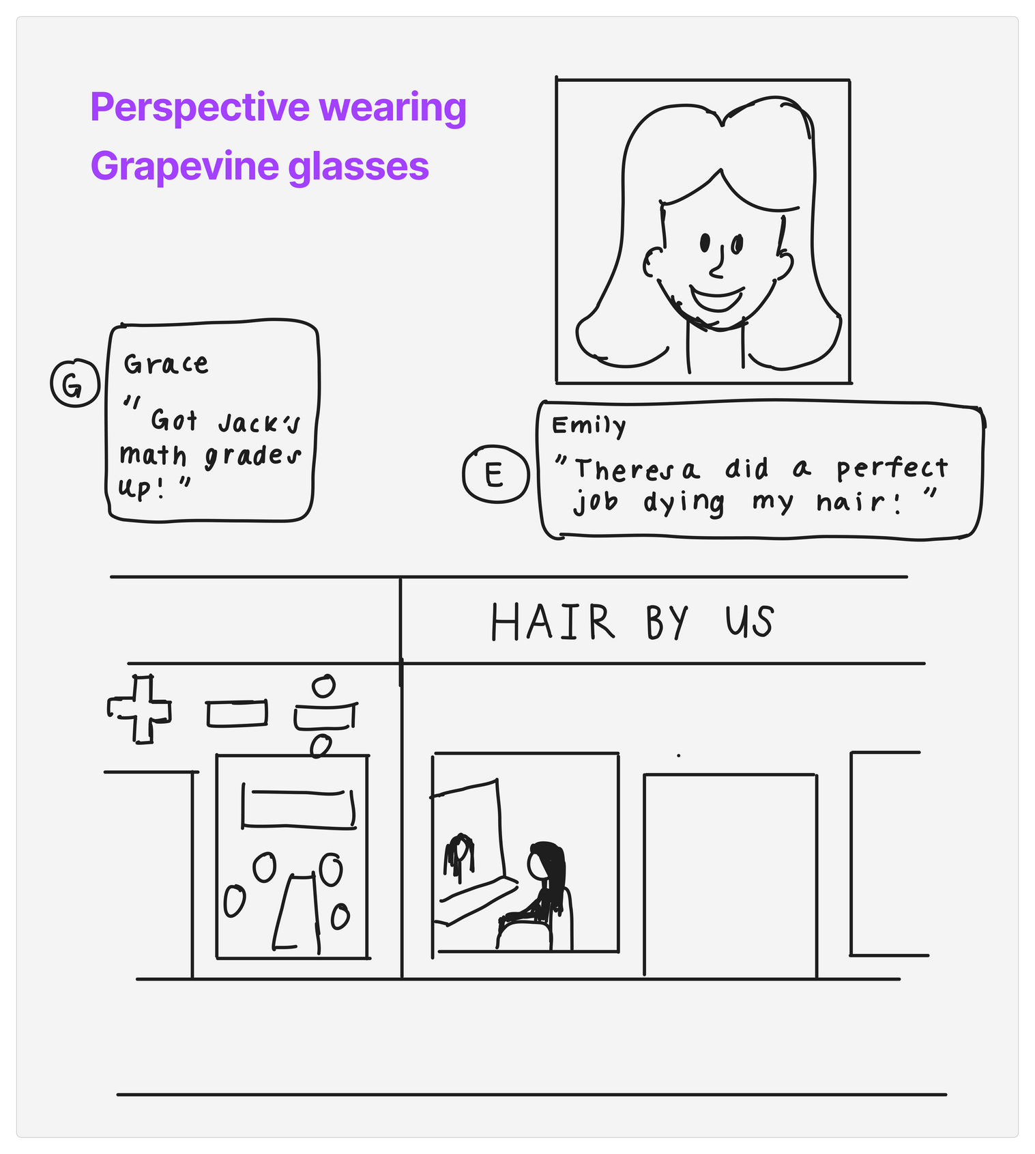
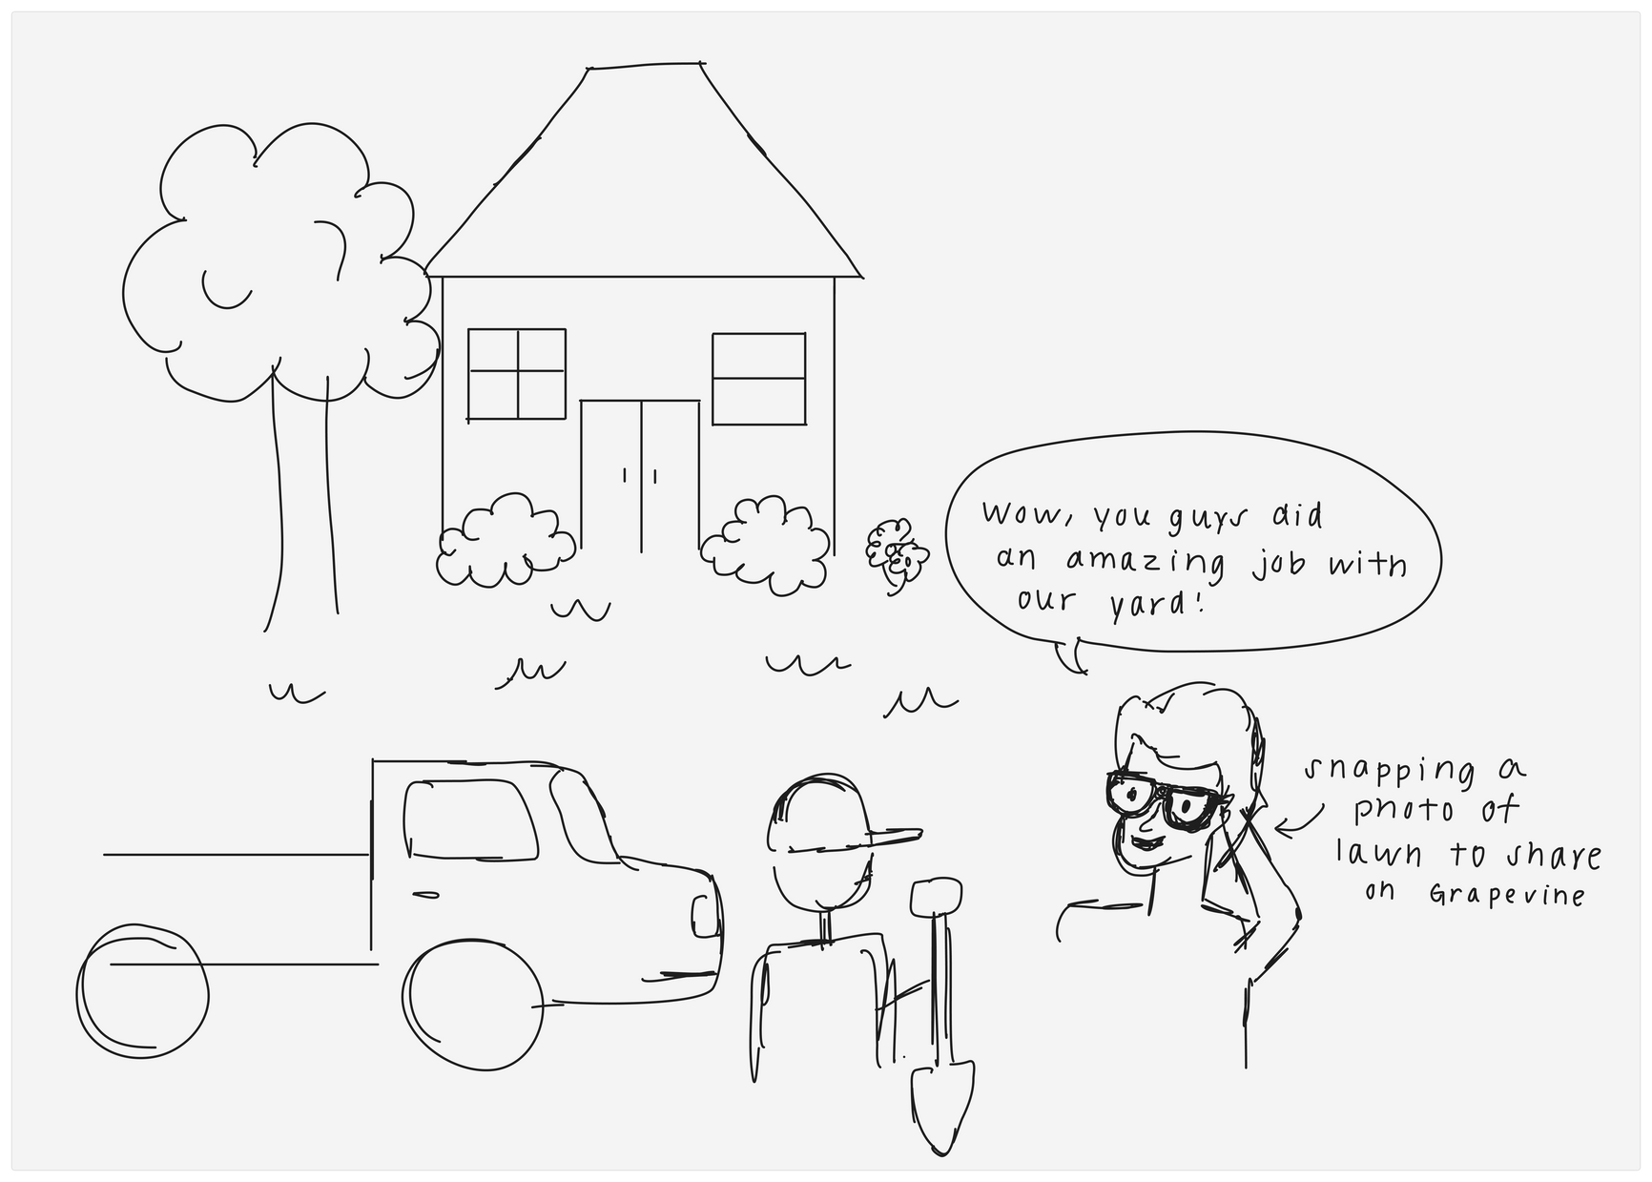
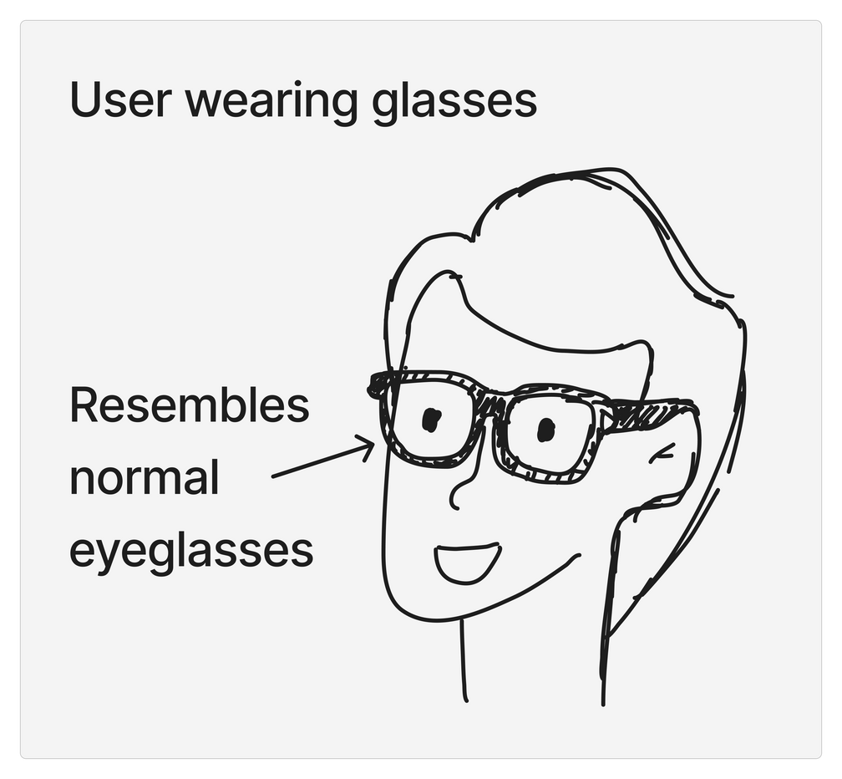
Sketching Explorations
Wearable Glasses

Slide 9
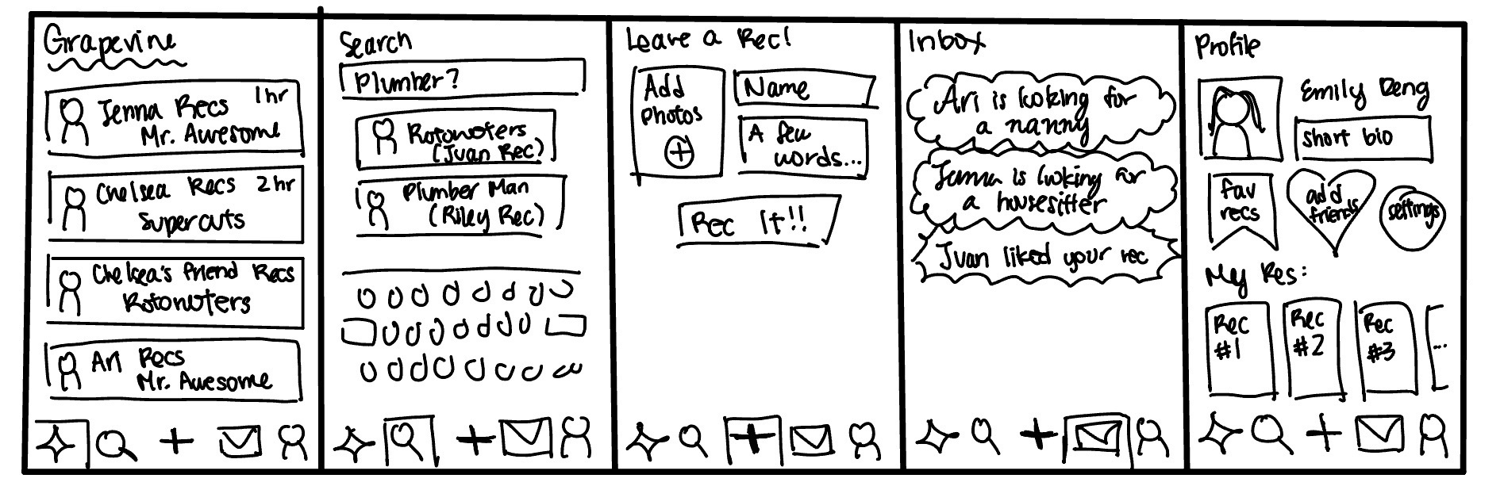
Sketching Explorations
Mobile App

Slide 10
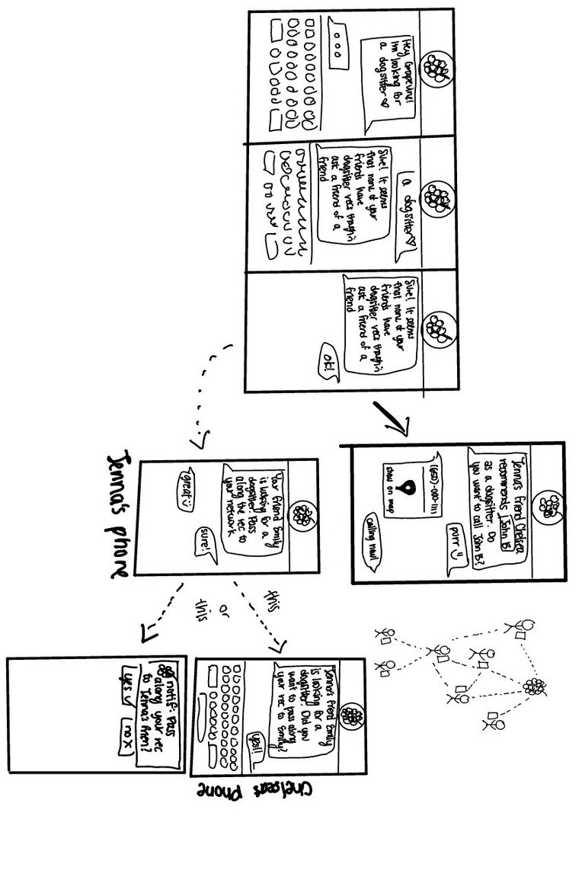
Sketching Explorations
Text Based

Slide 11
03
Selected Interface & Rationale

Slide 12
Top 2 Realizations
Mobile App &
Wearable

Slide 13
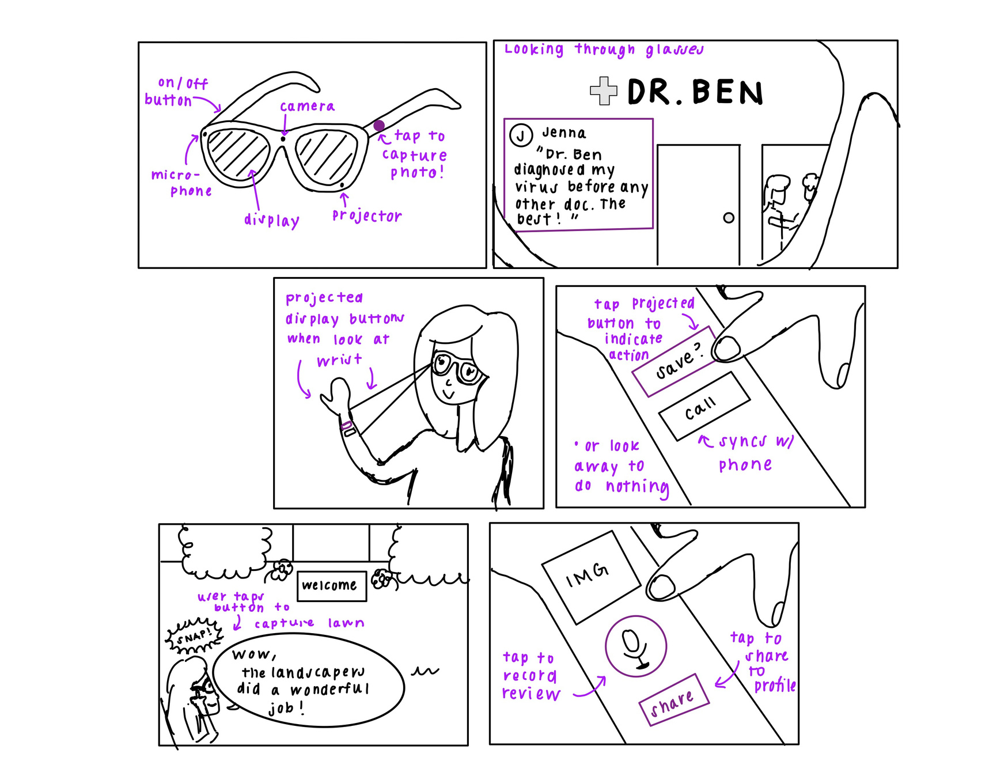
Diverse Realisation #1
Wearable

Slide 14
Wearable: Pros and Cons
Pros
Cons
People like cool gadgets
Users are guided by the glasses, which superimpose visual queues onto the user’s vision
Hands-free convenience
Users must carry around and wear the glasses
Not optimal for people who already wear glasses
Affordability issues
Vision health concerns and potential nausea

Slide 15
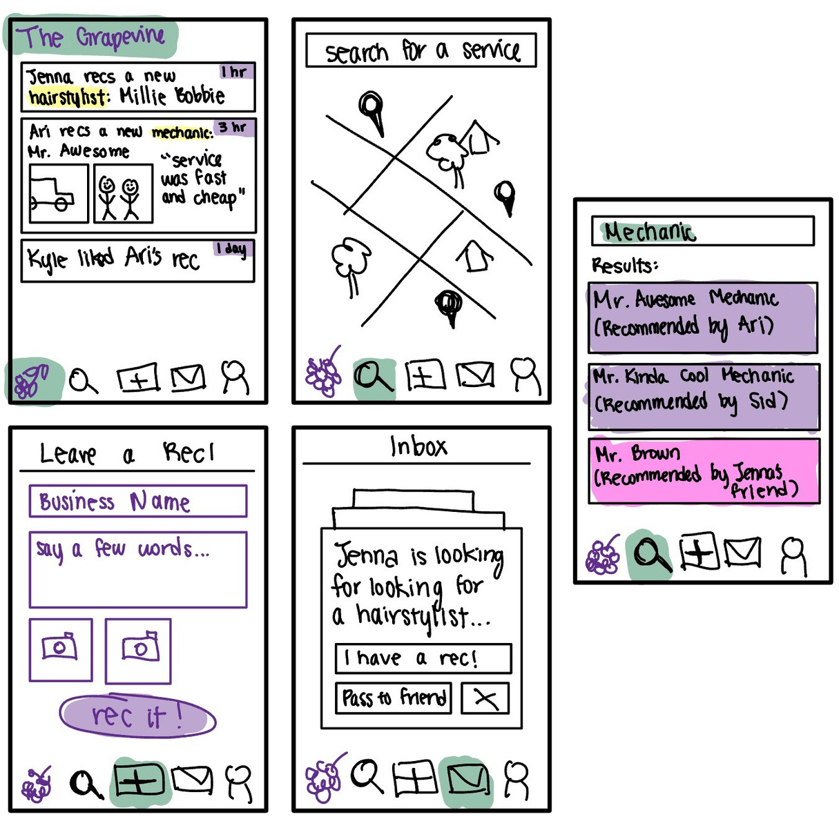
Diverse
Realisation #2
Mobile App

Slide 16
Mobile App: Pros and Cons
Pros
Cons
Accessible and portable: most people carry around smartphones
Coherent aesthetic
Easier to integrate more features than wearable or text-based
Can be used by a wide audience
App fatigue: people are averse to downloading another app and making another account
Learning curve: multiple tabs and complex functionality may confuse users
Compatibility issues

Slide 17

The Winner: Mobile App!
Why?
Mobile apps are easier to acquire, more familiar to the public, and more relevant in terms of the features we are trying to develop

Slide 18
04
Low-fi Prototype:
Construction & Task Flows

Slide 19
SIMPLE TASK
Searching for a recommendation

Slide 20
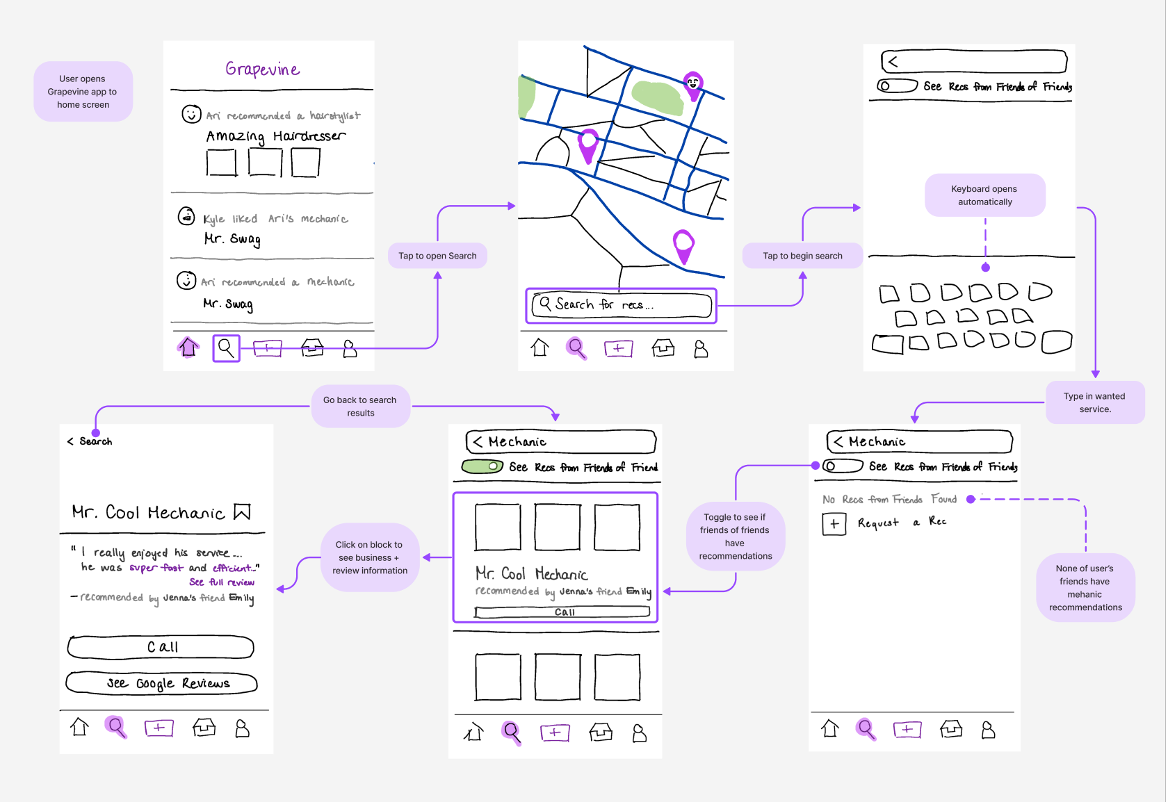

Slide 21
MODERATE TASK
Leaving a recommendation

Slide 22
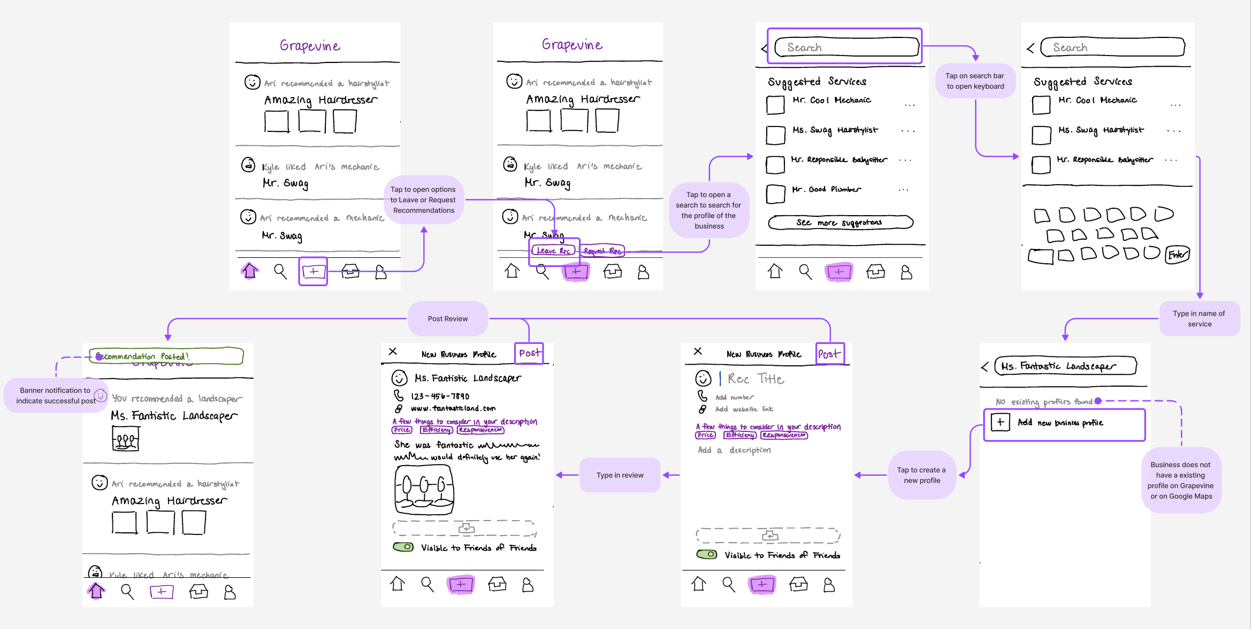

Slide 23
COMPLEX TASK
Requesting a recommendation from your network (including friends of friends); passing on a recommendation request to your friends

Slide 24
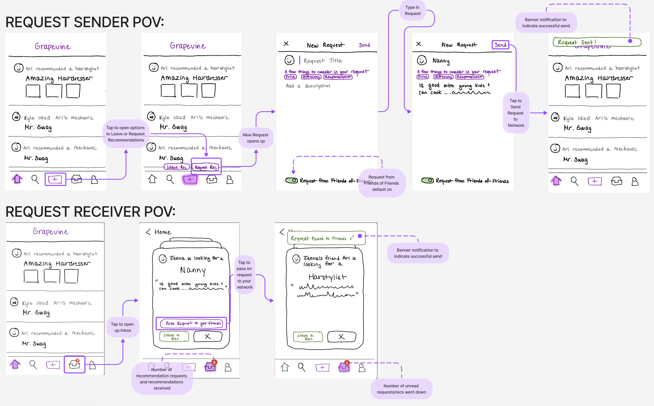

Slide 25
05
Testing Methodology

Slide 26

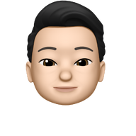
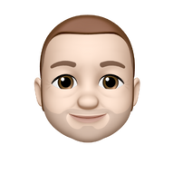
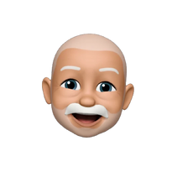

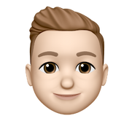
Participants
1 | Susan | 60-70 year old woman who lives in Menlo Park , met her at MPX Pilates
2 | Troy | 24 year-old working in finance with a computer science degree, met at Verve Coffee
3 | Ric | mid-50s working in sales, met at Tressider
4 | Benjamin | ~75 year-old Israeli immigrant, met at Verve Coffee
5 | Mackenzie | mid-30s working in lab equipment manufacturing, met at Tressider
6 | Bradon | mid-30s store employee, met at Trader Joe’s

Slide 27

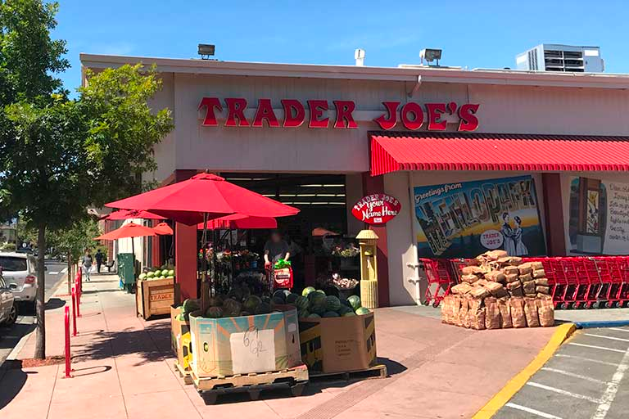
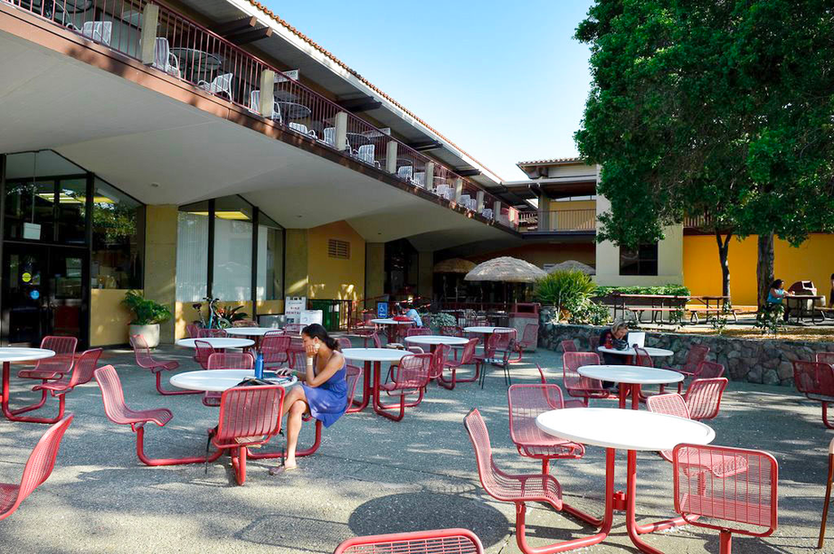

Testing
Environment
Verve
Palo Alto
Trader Joe’s
Menlo Park
NPX Pilates
Menlo Park
Tressider
Stanford
Campus

Slide 28
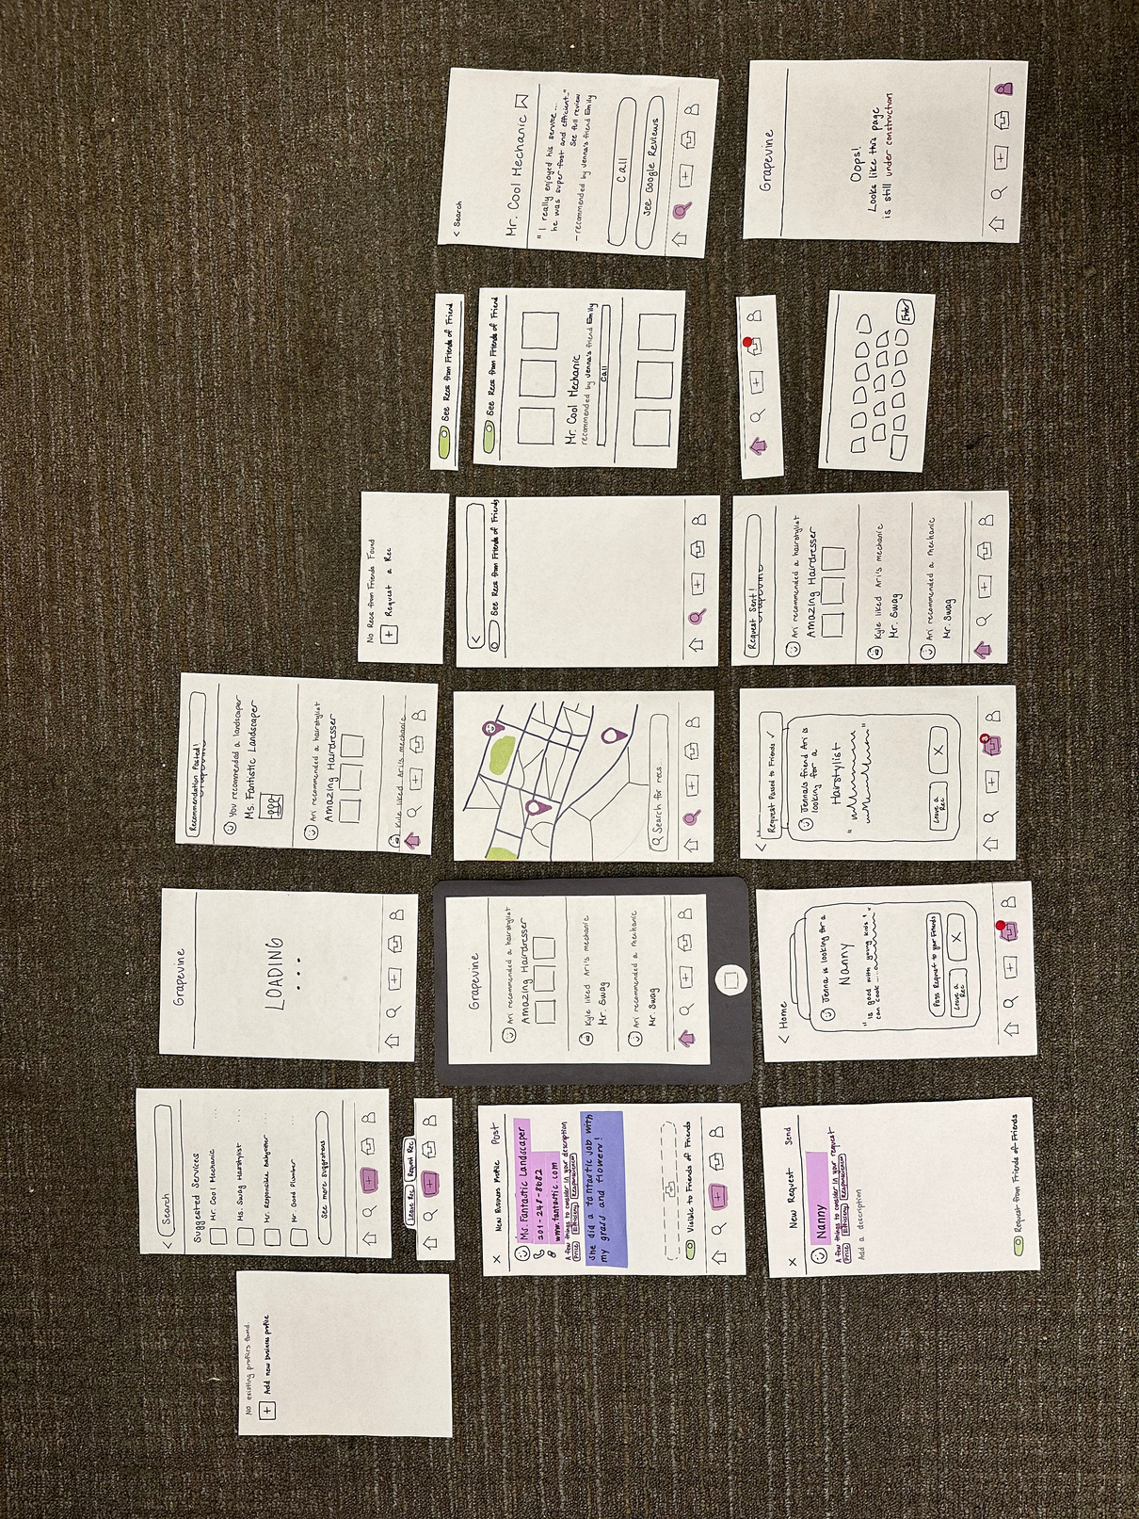

Apparatus
+

Slide 29
Construction
Screens were drawn digitally then printed on paper and cut out
Certain elements like the search bar, keyboard, and nav bar were cut as separate pieces to make switching them out easier
As testers tapped on buttons, the team quickly replaced the current screen with the corresponding next screen
Users could tap or type on the screen

Slide 30
Team Roles
Emily: Notetaker
Jenna: Facilitator
Ari: Videographer

Slide 31

The Process
“Sure!”
Hi! Would you have 8-10 minutes to help us with a school project?

Slide 32
USABILITY GOAL: EFFICIENCY
How long does it take to complete each of the tasks?

Slide 33
USABILITY GOAL: ROBUSTNESS
How many mistakes did the users m﻿ake to complete their tasks?

Slide 34
06
Testing Results

Slide 35

Big Picture
Participants were confused by similar-looking screens and the variety of features, but all managed to complete their tasks with some guidance.
Process Data

Slide 36

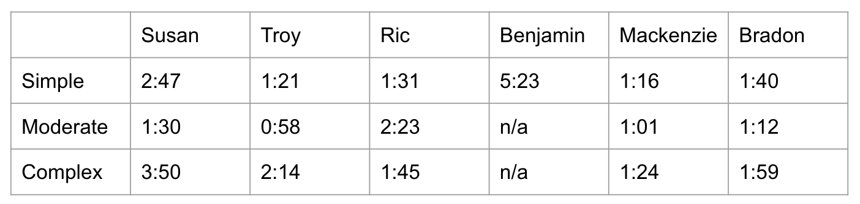
Metrics
Bottom-line Data

Slide 37
Metrics
Bottom-line Data
Average time to complete tasks:
Simple Task: 2:19 minutes*
Moderate Task: 1:24 minutes
Complex Task: 2:14 minutes
*outlier: Benjamin

Slide 38
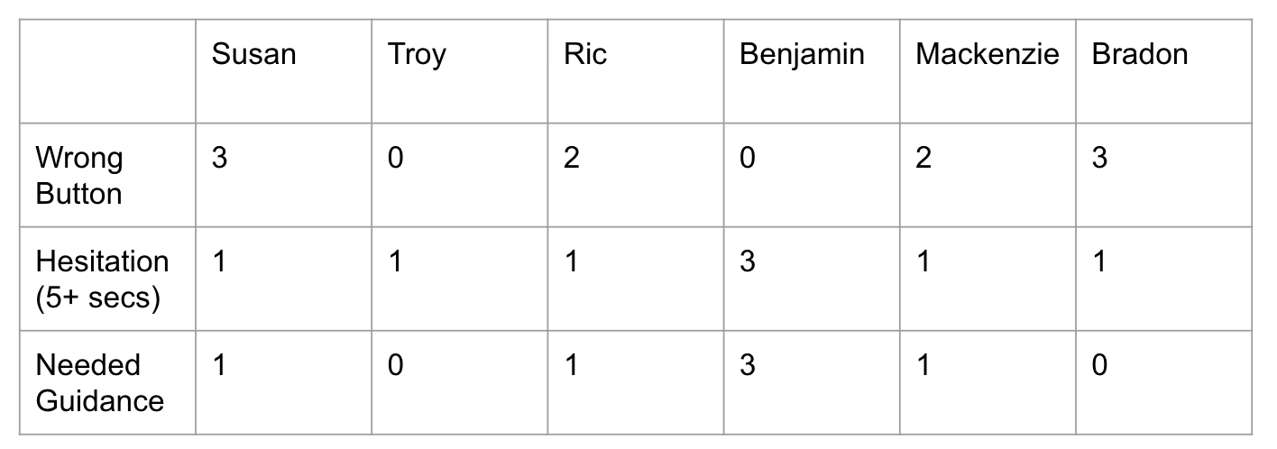
Metrics
Bottom-line Data

Slide 39
How well did we achieve our usability goals based on the key measurements?

Slide 40
The Verdict:
Efficiency: B Robustness: B-
Overall, participants took longer than we expected to complete all the tasks, especially simple. A critical mistake was navigating down a wrong path, which led to many wrong buttons. However, all users were eventually able to complete all the tasks with some prompting.

Slide 41
Relevant Observations
When no friend recommendations appeared, half of the participants defaulted to requesting recommendations rather than first toggling on seeing recommendations from friends of friends.
People didn’t realize that they had to click “Post” after writing their recommendation.
When trying to request a recommendation, most people went to the search tab and requested through the search tab rather than the plus button on the navbar
Simple
Moderate
Complex

Slide 42
07
Observations & Implications

Slide 43
THE BAD

Slide 44
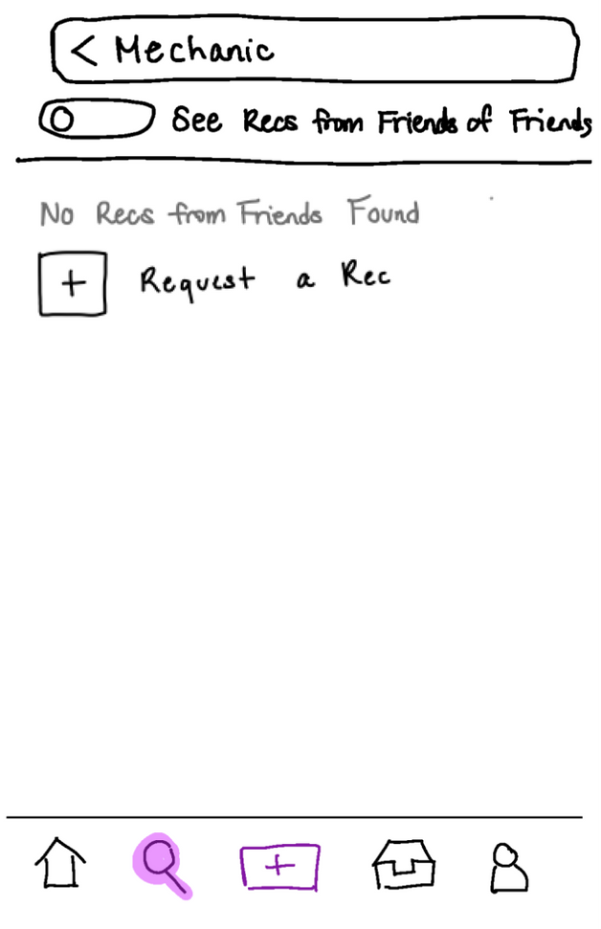

Observation:
Toggling more Recs
📝: Finding a recommendation (simple)
When no friend recommendations appeared, half of the participants defaulted to requesting recommendations rather than first toggling on seeing recommendations from friends of friends.
Requesting Recommendations

Slide 45
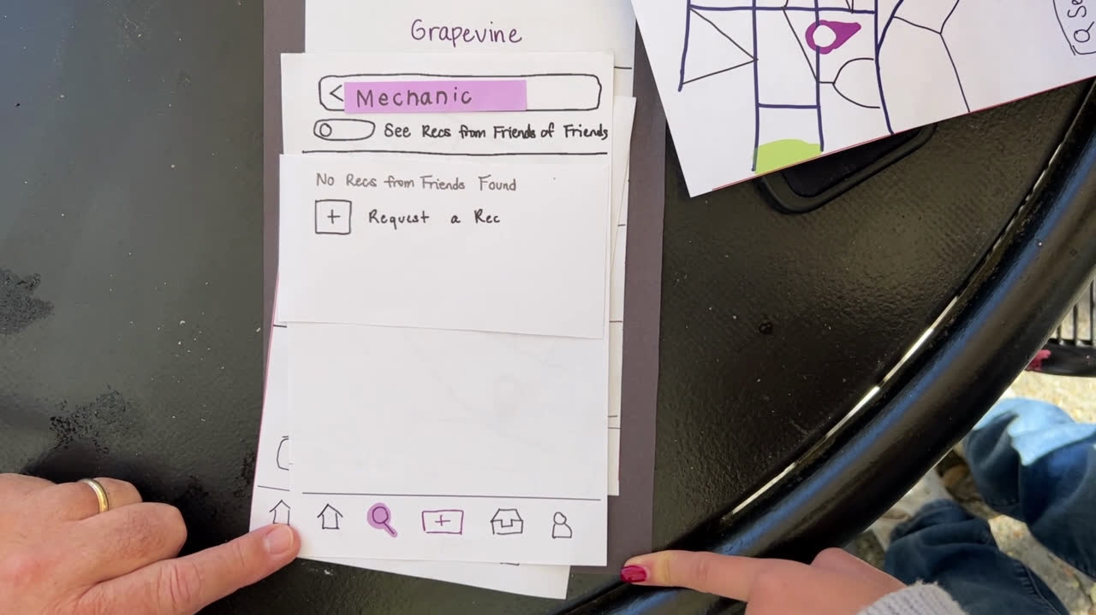
Implication:
📝: Finding a recommendation (simple)
If we want to prevent users from immediately requesting a rec, we should emphasize the option to see recommendations from friends of friends or maybe eradicate the toggle altogether and default to everyone.

Slide 46

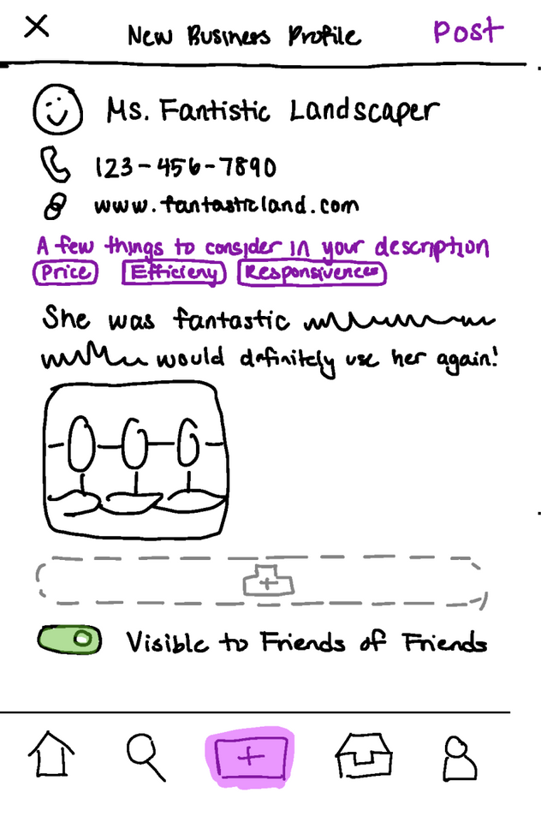
Observation:
📝: Leaving a recommendation (moderate)
People didn’t realize that they had to click “Post” after writing their recommendation.

Slide 47
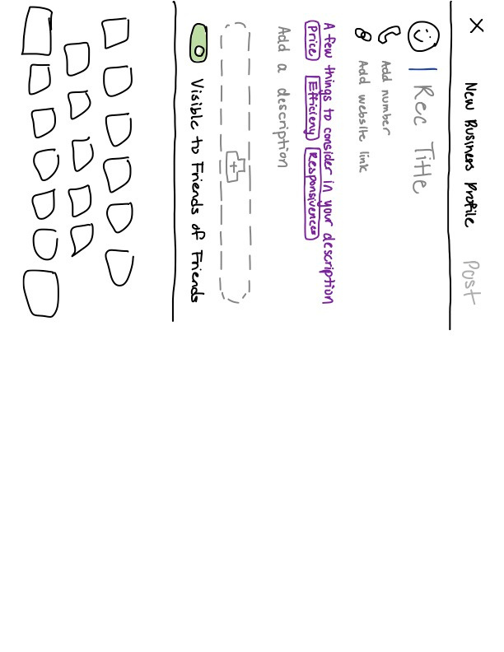
Observation:
Implication:
📝: Leaving a recommendation (moderate)
We should better indicate when buttons are active and not active.
People didn’t realize that they had to click “Post” after writing their recommendation.

Slide 48
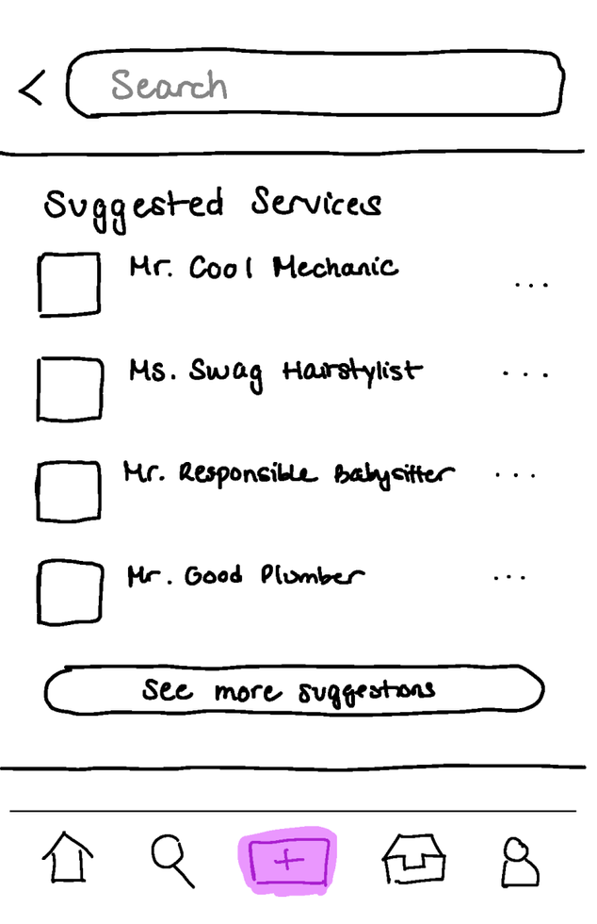
Observation:
📝: Leaving a recommendation (moderate)
Having a “Suggested Businesses” section, as in a suggested businesses to recommend, was confusing to people.

Slide 49
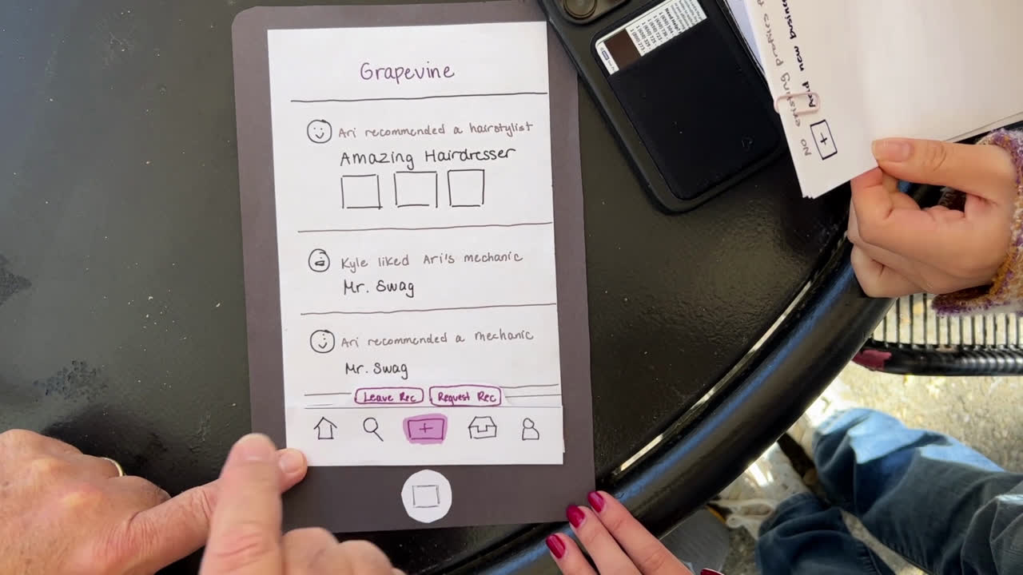
Implication:
Since searching for recommendation and leaving recommendations both entail searching, we should clarify our copy between the flows to prevent confusion

Slide 50
THE MEDIOCRE:

Slide 51
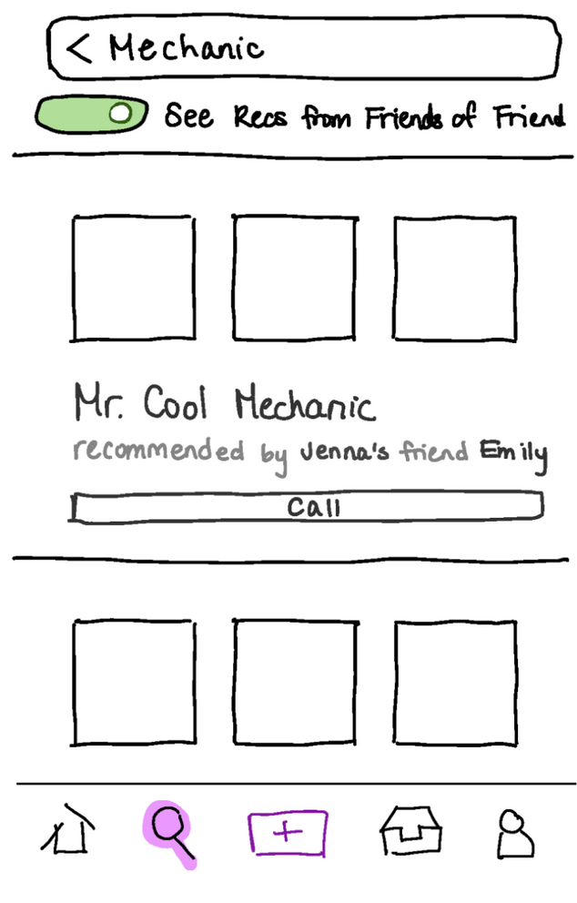
Observation:
📝: Finding a recommendation (simple)
Some participants automatically clicked the “Call” button instead of clicking onto the business’ profile as we expected

Slide 52
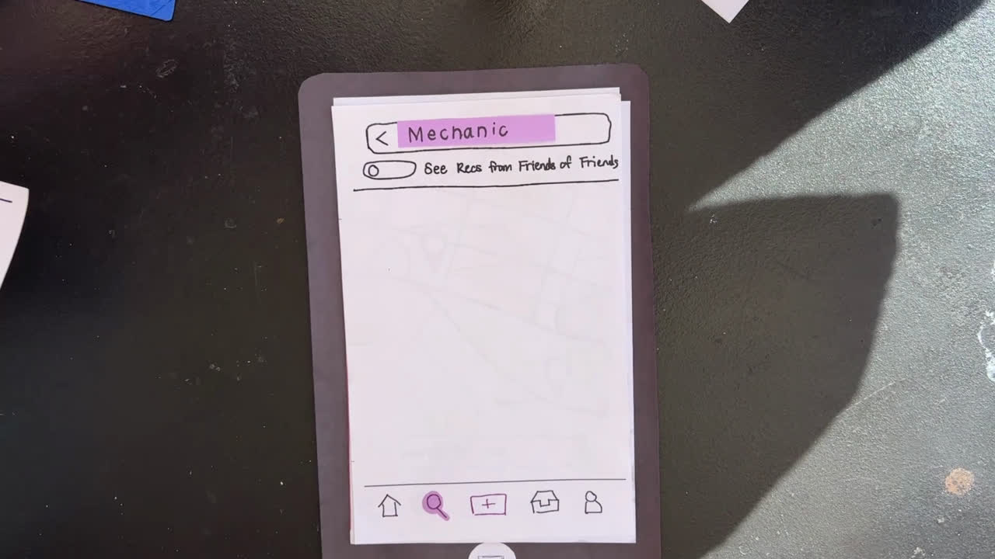
Implication:
Either people would rather call the business first rather than learning more, the “Call” button was very compelling, or there wasn’t enough of an indication that you could click into a business’ profile

Slide 53
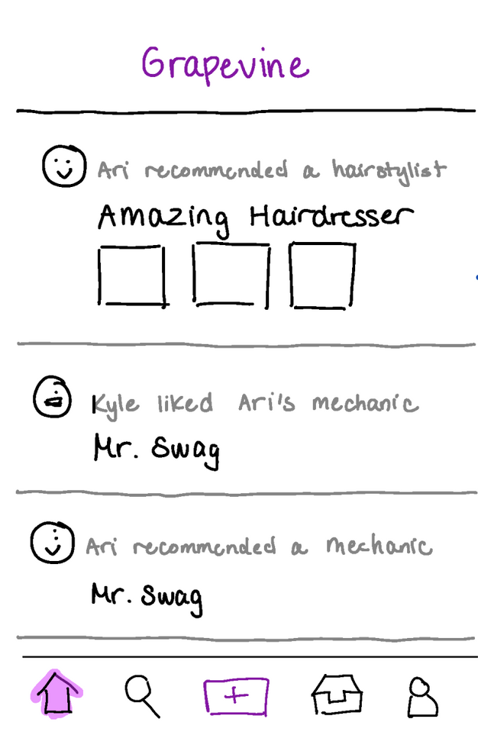
Observation:
📝: Request a recommendation (complex)
When trying to request a recommendation, most people went to the search tab and requested through the search tab rather than the plus button on the navbar
What we expected them to click

Slide 54
Observation:
Where they actually went
📝: Request a recommendation (complex)
When trying to request a recommendation, most people went to the search tab and requested through the search tab rather than the plus button on the navbar

Slide 55
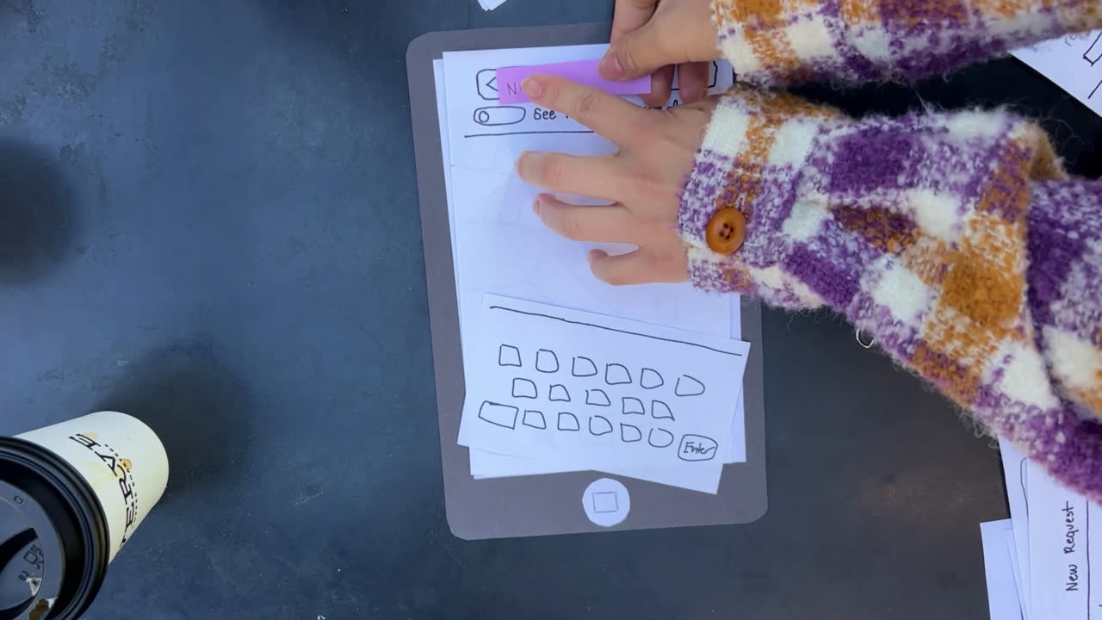
Implication:
It is more intuitive to users to request through the search tab, even though our intention was for requesting via search to be a last resort after no search results are found. We should either make the requesting from the plus button more prominent or even get rid of that pathway entirely

Slide 56
THE GOOD:

Slide 57
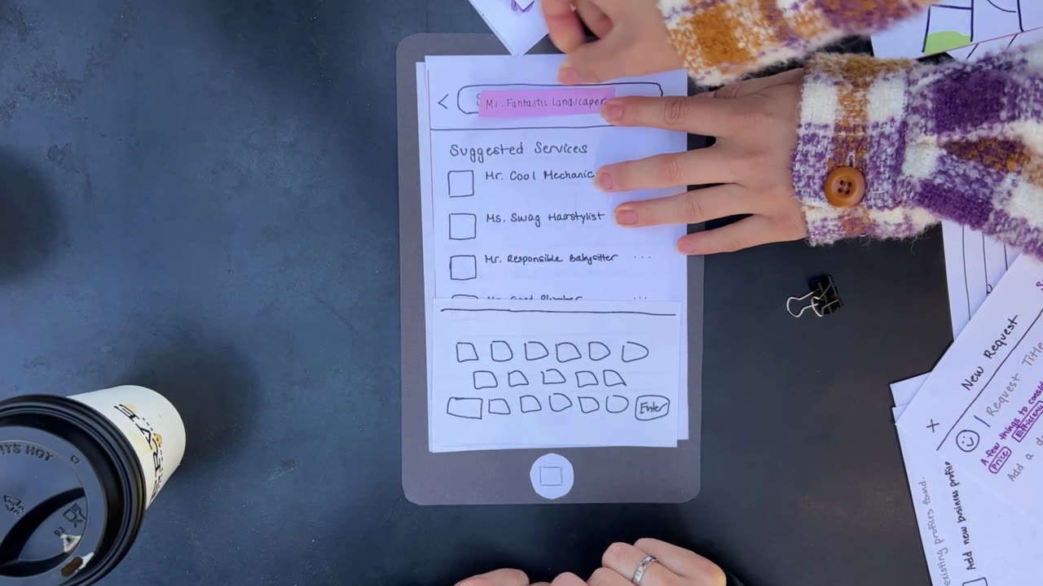
Observation:
People had an easy time searching and understanding the concept of recommendations from friends of friends

Slide 58
Implication:
Our easy task is easy! That flow should be preserved, and there is no need to explain the concept of friends of friends or tapping into your friends’ networks.

Slide 59
Observation:
Implication:
Everyone was able to request a recommendation, even if it wasn’t via the flow we expected people to take
Having multiple pathways to achieving the task could be useful, especially if a need for the task could arrive in different scenarios (i.e. requesting a rec after no serach results vs requesting a rec with someone specific in mind)

Slide 60
Next Steps

Slide 61
Better indicate button activation
Change how recommendations from friends of friends become visible
Based on our tests,
we plan to....
Change the default page to search
Make certain flows entail less clicks
Resolve c﻿onfusing copy

Slide 62
How much people want to see recommendations from friend﻿s of friends
What can testing not reveal?
How often people would actually leav﻿e recommendations
Whether or not people would reach for Grapevine over Google

Slide 63
08
Appendix

Slide 64
Wearable: Pros and Cons
Pros
Cons
People like cool gadgets
Users are guided by the glasses, which superimpose visual queues onto the user’s vision
Hands-free convenience, easily take pictures and post recommendations
Unique product, less competition
Immersive experience
AR/VR integration
Can be connected to smartphones (think Apple Watch)
Can be connected to other smart products (IoT)
Potentially more accessible
Future Expansion of features: health and fitness tracking
Users must carry around and wear the glasses
Harder to integrate software updates
Not optimal for people who already wear glasses
Affordability issues
Battery life, needs separate charger probably
Privacy concerns, especially given built-in camera
Fashion and aesthetics — some people don’t like glasses
Learning curve — not everyone is familiar with wearable technology
Health concerns with wearing smart glasses for prolonged periods
Sustainability and waste

Slide 65
Mobile App: Pros and Cons
Pros
Cons
Accessible and portable: most people carry around smartphones
Coherent aesthetic within app
Easier to integrate more features than wearable or text-based
Can be used by a wide audience
Push notifications can be enabled or disabled
Navigable visual map
Better performance for specific tasks
Potential integration with other apps (Google Maps)
From a developer standpoint:
software is easier to update
less NLP than text-based
People are averse to downloading another app and making another account, especially people we interviewed
Learning curve: multiple tabs and complex functionality may confuse users
reliance on WiFi as opposed to just service
Takes up storage space
Privacy concerns
Potentially addicting (think Instagram Explore or even Venmo transactions page)
From developer standpoint:
Competetive app market
Developing a cross-platform app that is compatible across different phone types

Slide 66
Script
(Introduce ourselves and the premise of our app) “Our app allows users to see what services their friends are using and liking. In terms of services, we mean mechanics, plumbers, nannies, or even people like doctors. Our app actually extends your network beyond just immediate friends, connecting friends of friends as well. Of course, users can also leave recommendations for their own favorite services to share with others. We picked this domain because public reviews for services are often sparse or misleading, and we picked this solution because people generally trust their network for good service recommendations.”
(Simple Task) Ok, so let’s imagine that your car broke down, and you’re looking for a mechanic. Can you try to search among your network for a mechanic that you could visit?
(Moderate Task) Great! Now let’s imagine that you really liked a landscaper you worked with recently. Her name is Ms. Fantastic Landscaper. You want to leave a good recommendation to share with your network. How would you go about doing that?
(Complex Task: Sender) Ok so some time has passed and now you’re looking for a nanny. Can you try finding a nanny?
...So you may have noticed that no one in your network has a recommendation for a nanny right now. Can you think of how you may request a recommendation, in case one of your friends just hasn’t inputted their information into the app? Essentially, you want to make a recommendation request for a nanny.
(Complex Task: Receiver) Nice job! I see that you have sent this request out among your friends. Now let’s imagine that you are your friend, so you just received the request for the nanny. Unfortunately, you don’t have a nanny in mind to fulfill the request. How would you respond to this screen
Great! Thanks for passing along the request to your network, perhaps one of them will have a good nanny recommendation!

Slide 67
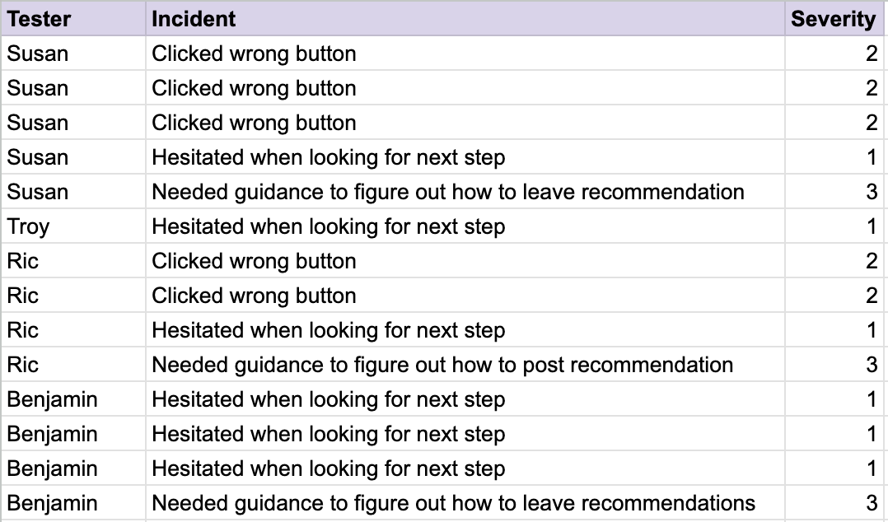
Critical Incident Log

Slide 68
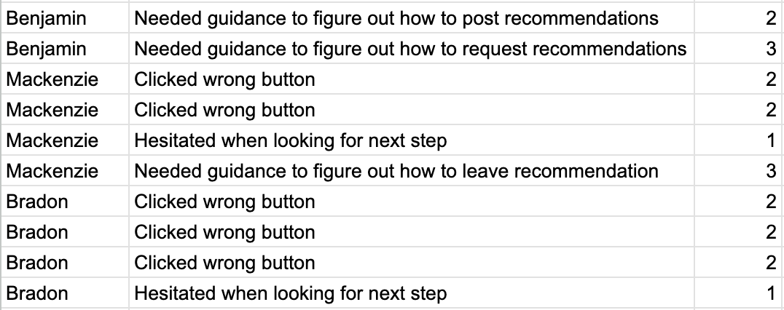
Critical Incident Log (cont.)

